Slide 1
Dogs, Fried Chicken or Blueberry Muffins?
By Linna Yu, Mengqi Chen, Michael Utomo, Shan He and Yuhao Kang

Slide 2
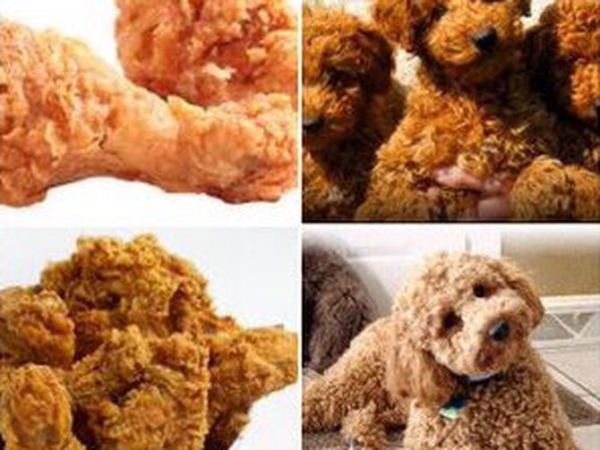
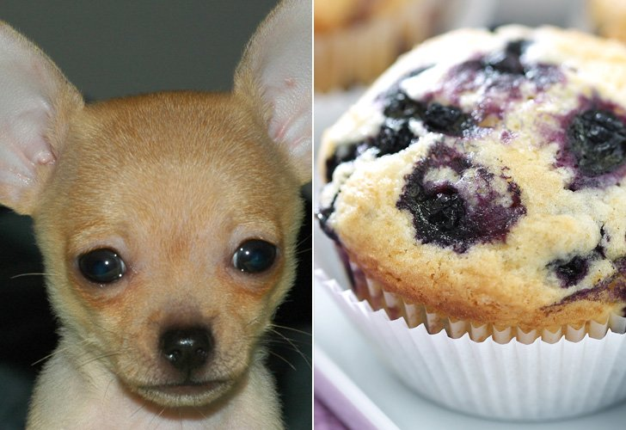
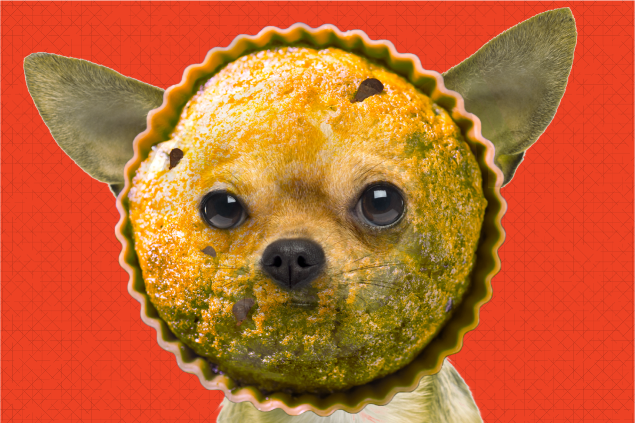

Slide 3
How???
Image analysis:
1. SIFT
2. HOG (Histogram of oriented gradients)
3. CNN (Convolutional Neural Network)

Slide 4
HOG(Histogram of oriented gradients)
Get the gradient of each pixel
Separate into small cells
Get the histogram of the frequencies of the gradients for each cell
Create blocks with several cells, and get the info of the blocks
Combine the info of blocks and get the info of the image

Slide 6
How???
Classification methods:
1. GBM
2. SVM
3. Random Forest
4. Logistic Regression
5. XGBoost
6. Neural Network

Slide 7
Results: Model Running Time
 | GBM | SVM | Random Forest | Logistic Regression | XGBoost | Neural Network
SIFT | 240sec | 70.2sec | 1620sec | 41.27sec | 1.004sec | 13.23sec
HOG | 10.3sec | 4.58sec | 13.56sec | 0.6996sec | 0.2587sec

Slide 8
Results: Testing Accuracy

Slide 9
Final Decisions

Slide 10
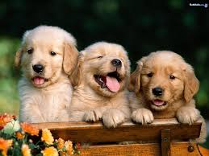
Thank you!

